Slide 1
Nonrefundable & Refundable Credits Overview, Foreign Tax Credit
Pub 4012 Tab G
Pub 17 Chapter 37
(Federal 1040-Line 48)
Notes:
1

Slide 2
Definitions
Credit – a dollar-for-dollar reduction of the tax liability
Nonrefundable Credits – can reduce the tax liability to zero, but does not provide a refund of excess credit
Appear in Nonrefundable Credits section of 1040
Refundable Credits – can reduce the tax liability to zero & provide a refund of excess credit
Appear in Payments Section of 1040
Notes:
Recap: Credits are different than Adjustments.
Credits are dollar for dollar reduction of tax liability
Adjustments are dollar for dollar reduction to Income.
Nonrefundable credits are applied against the tax liability in the order that they are listed on 1040
2

Slide 3
Nonrefundable Credit Foreign Tax Credit – 1040 Line 48
Pub 4012 Tab G
Reported to taxpayer on 1099 INT or 1099 DIV (usually on brokerage statement)
Only In Scope if < $300 ($600 MFJ)
Enter at the top of Form 1116 page 1
When Foreign Tax Credit appears on 1099-INT or 1099-DIV, enter it immediately (out of sequence). Do not wait until you get to 1040 Line 48. Otherwise, it may be lost or forgotten
The rest of Form 1116 is Out Of Scope
Notes:
Suggestion about entering Foreign Tax Credit immediately when you see it on a tax document, is guidance for real tax returns. When doing in class or proficiency problems, follow the order on the refund monitor
3

Slide 4
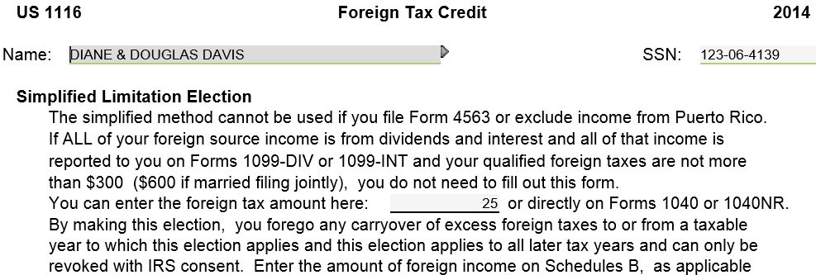
TW Form 1116 – Foreign Tax Credit
Notes:
Although you usually enter information in the order of the 1040 form, you should enter Foreign Tax Credit from 1099-INT or 1099-DIV on Form 1116 as soon as you see it. Don’t wait until you get to 1040 Line 48. You may forget about it by that time since you have already finished with the Interest/Dividend source documents.
Only fill in the Foreign Tax Credit at the top of Form 1116. Rest of the Form is Out of Scope & can remain red. Does not show as red in Forms Tree
4

